Slide 1
Project Title : Superstore Sales and Profit Analysis
Student Name : Viraj Vinod Bele
College Name : DKTE Society’s Textile and Engineering Institute , Ichalkaranji.
Branch : AI and Data Science
Semester : 5th
AICTE ID : STU662ba6ddc52c41714136797

Slide 2


PROBLEM STATEMENT
The aim of this project is to analyze the sales and profit trends across different regions, categories, and sub-categories for the Superstore dataset. The objective is to identify key insights and help improve decision-making for regional and category-specific strategies.

Slide 3
Project Description
This project involves analyzing the Superstore dataset to explore and visualize sales and profit data. We examine the data across various dimensions, including Region, Category, and Segment. Insights derived from the analysis help in understanding sales and profit distributions, identifying high-performing areas, and highlighting opportunities for growth.“
Visuals: Consider adding screenshots or graphs showing overall sales and profit trend

Slide 4

WHO ARE THE END USERS?
Sales Managers, to understand performance across regions and categories.
Marketing Teams, to target high-performing regions and improve weak areas.
Business Analysts, to identify patterns in profitability and guide strategic decisions.

Slide 5

Technology Used
Language: Python
Libraries:
Pandas
Matplotlib
Seaborn
Numpy
IDE : VS Code

Slide 6
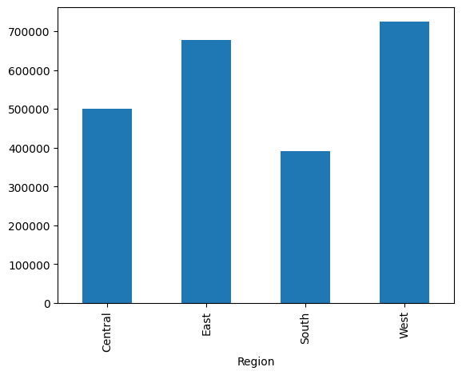
RESULTS
1. Bar Diagram for Sales by each Region
Approach:
The data is grouped by the Region column to calculate the total sales for each region.
Visualization through a pie chart or bar chart provides a clear view of the proportion of sales contributed byeach region
Findings:
Highest Sales Region: For example, the West region have the highest sales, indicating strong demand or effective marketing in that area.
Lowest Sales Region: If, for instance, the South region has the lowest sales, this might suggest a need for strategic improvements in that region.

Slide 7
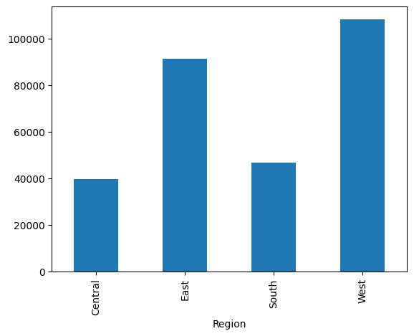
RESULTS
2. Bar Diagram for Profit by each Region
Approach:
I grouped the data by Region and calculated the total profit for each region.
Visualization, such as a bar chart provided a clear comparison of profits across regions.
Findings:
Highest Profit Region: For example, if the East region has the highest profit, this may indicate strong demand and efficient cost management.
Lowest Profit Region: Conversely, if the South region shows lower profits, it may suggest high operating costs, lower margins, or a need for process improvement

Slide 8
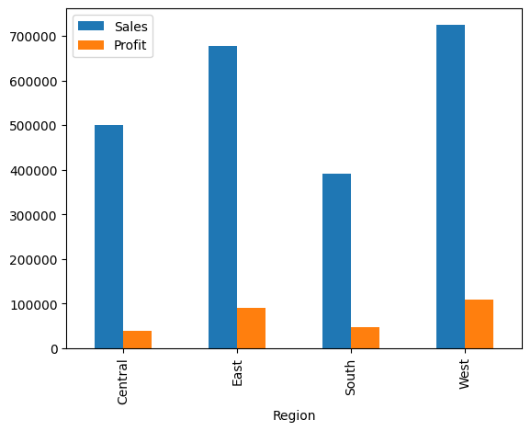
RESULTS
3. Joint Bar Diagram of Profit and Sales by Region
Approach:
I grouped the data by Region and calculated the total Sales and Profit for each region.
A joint Bar chart is created with side-by-side bars representing Sales and Profit for each region, making it easy to visually compare the two metrics.
Findings:
High Sales & High Profit Region: For example, if the West region shows both high sales and high profit, it may indicate a strong demand combined with efficient operations in that region.
High Sales & Low Profit Region: If the South region shows high sales but lower profit, it might suggest high operational costs or the need for better pricing strategies to improve margins.
8

Slide 9
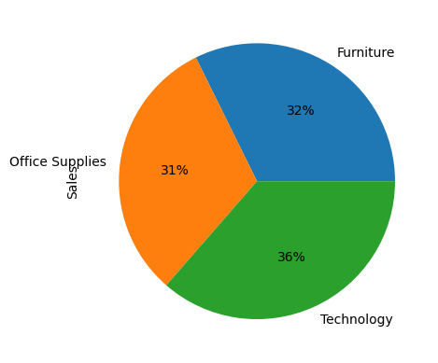
RESULTS
4. Pie chart - Percentage of Sales by Category
Approach:
The total sales is grouped by category to calculate each category's share of the overall sales.
A pie chart was used to visualize these proportions, making it easy to see the contribution of each category as a percentage of total sales
Findings:
Top-Contributing Category: The Technology category has the highest percentage, this indicates a strong customer demand and a significant role in revenue generation.
Lower-Contributing Categories: The categories like Furniture or Office Supplies contribute less to total sales, this may suggest potential areas for growth through targeted marketing or product expansion.

Slide 10
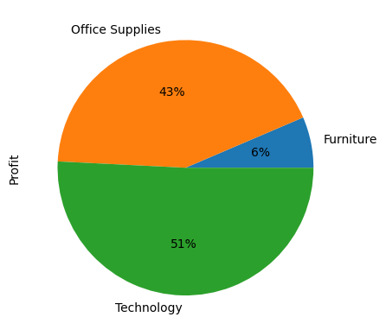
RESULTS
5. Pie chart - Percentage of Profit by Category
Approach:
Total profits were grouped by category to calculate each category's share of the overall profit.
A pie chart is used to visualize these proportions, making it easy to see the contribution of each category as a percentage of total profit.
Findings:
Top-Contributing Category:
The Technology and Office Supplies category accounts for 51% and 43% of total profit, it indicates strong profitability, suggesting effective cost management and high demand.
Lower-Contributing Categories:
The category like Furniture contribute only 6% this may highlight potential issues such as higher costs or lower sales, indicating areas for improvement.
10

Slide 11
Thank you
.
.

